Slide 1
ARM Part-II
September 2021

Slide 2
Many of today’s most popular 32-bit microcontrollers use RISC technology. Unlike CISC processors, RISC engines generally execute each instruction in a single clock cycle, which typically results in faster execution than on a CISC processor with the same clock speed.
Increased performance, however, comes at a price: a RISC processor typically needs more memory than a CISC does to store the same program. Many of the complex functions performed in a single, slow, instruction in a CISC processor may require two, three, or more simpler instructions in a RISC.
Except in the most speed-critical of embedded devices, the cost of memory is much more critical than the execution speed of the processor. To reduce memory requirements and, thereby, cost, Advanced RISC Machines (ARM) created the Thumb instruction set as an option for their RISC processor cores. The most well-known chip that includes the Thumb instruction set is the ARM7TDMI. The “T” in the core’s full name specifies Thumb.

Slide 3
Getting into Thumb Mode.
Core has two execution states ARM and Thumb;
Thumb is a compressed and 16 bit representation of a subset of the ARM instruction set.
Like ARM, Thumb also uses load store architecture for data processing, data transfer and control flow instructions.
The standard chip that includes the Thumb instruction set is the ARM7TDMI where "T" specifies Thumb. (Remember this, we saw this in CPSR ;))
ARM by Shriram

Slide 4
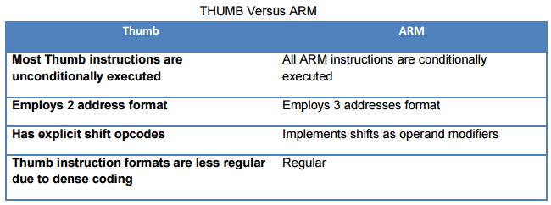
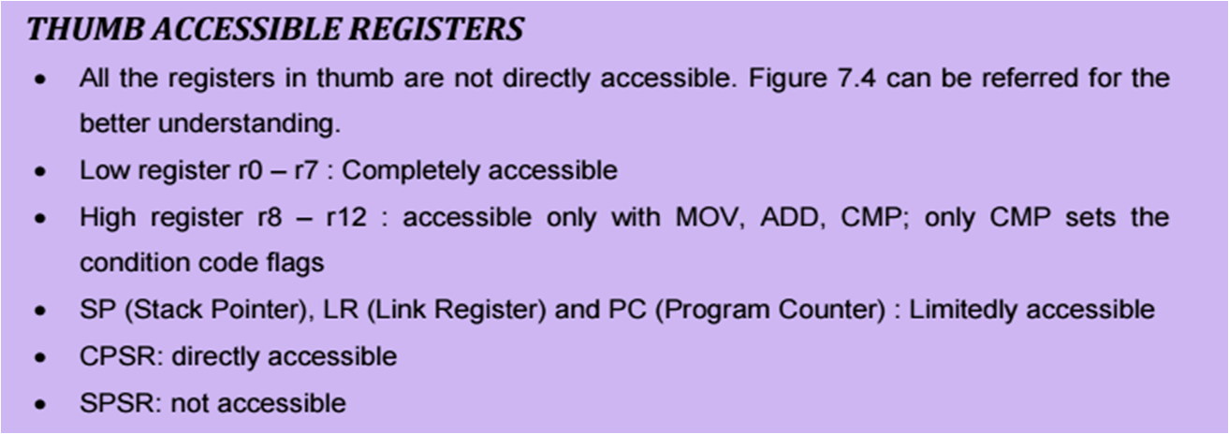
ARM by Shriram

Slide 5
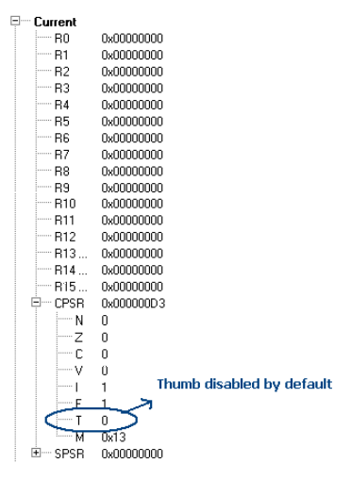
How to set thumb state?
D3 is the default value for the CPSR as shown in the below. So by default one can observe that the Thumb state is disabled. To get it enabled, as already discussed CPSR should be accessed and T bit should be set.
ARM by Shriram

Slide 6
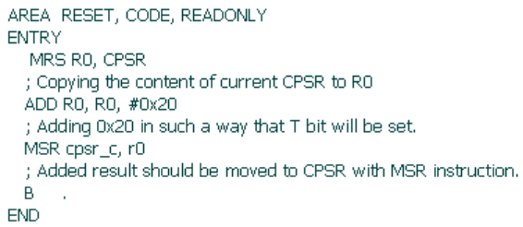
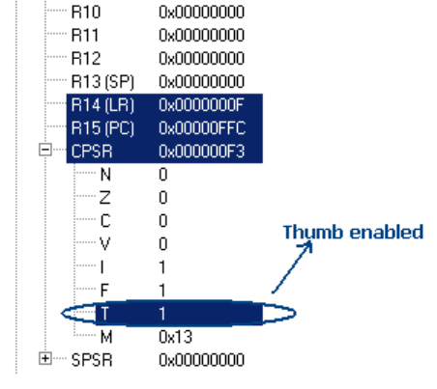
Setting the T bit can be done by adding 0x20 to the D3. It will then set the T bit and eventually the THUMB mode will be set
ARM by Shriram

Slide 7
Try these all with ARM.
1. Write a program to find greatest of three numbers.
2. Write a program to SWAP two values without using the third variable.
3. Write a simple code to find out if a number is prime or not.
4. Write a program to SWAP upper and lower nibbles of a number.
5. Write a program to disassemble a value. E.g. 54H to 05H and 04H.
6. Write a program to convert ASCII value to BINARY.
7. Write a program to convert HEXADECIMAL to BINARY.
8. Factorial of a given number.
9. Fibonacci series.
10. Prime number or not.
11. Sorting the numbers in a series.
ARM by Shriram

Slide 8
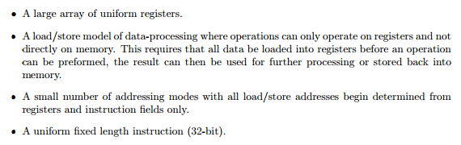
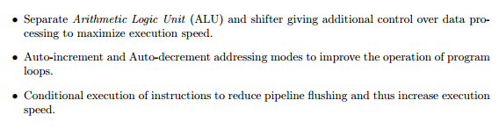

Recollect all these
ARM by Shriram

Slide 9
Queries

